Slide 1
What is Tony’s Problem

Slide 2
Project GUIDE
https://sound-au.com/clocks/arduino.html Updated February 2021
Real Time Clock (RTC) is an electronics part DSC3231.
Dual relay module electronics part.
Nano and Real Time Clock Wiring.
Library for Real Time Clock requires a Library download.
Alternating or Single Polarity Pulse clock examples.

Slide 3
Getting a pulse with a Real Time Clock
Didn’t work on my PC!
Wasn’t clear if your equipment was functioning.
No troubleshooting guide.
It was unclear how to use different Arduino boards with it.
We don’t all speak the C software language every day.

Slide 4
Issue to Resolve
Arduino Board didn’t work
Cable
Computer
Instruction were hard to follow
Easy to miss steps
Code examples may not work
New skills to learn
Miniaturisation
Difficult to wire and see
Board layouts different
IDE didn’t work on Tony’s laptop

Slide 5
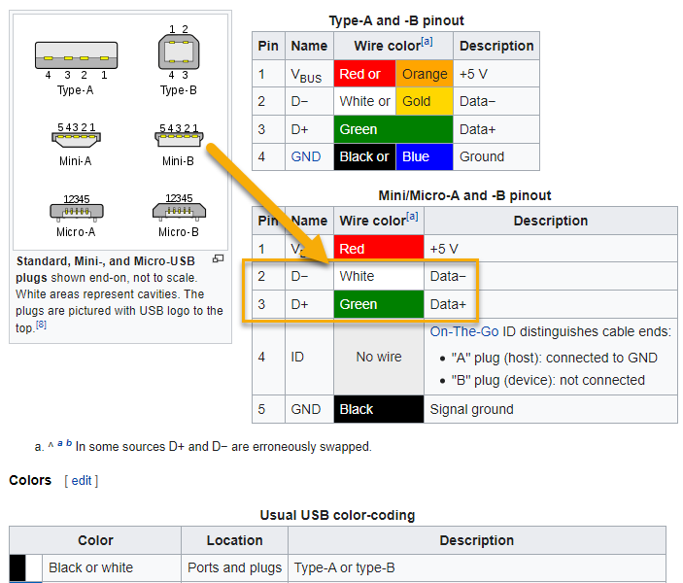
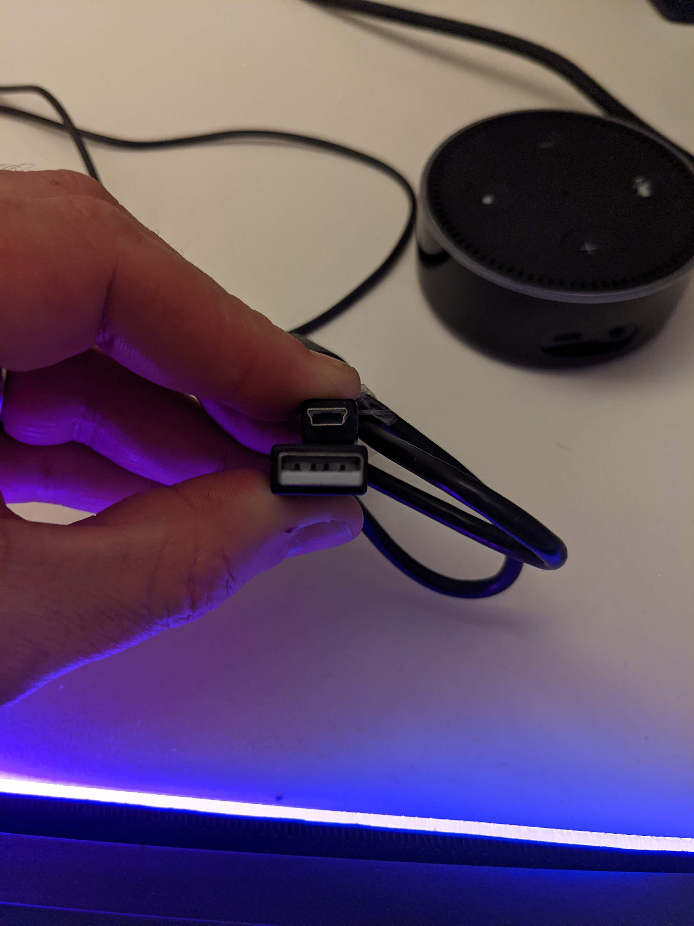
Test - Different Cables
Group source USB-Mini-B
Determine if the Laptops behave differently with another Cable

Slide 6
Back To basics
The internet knows all things (we hope)
Find your hardware pin diagram
Nano RP2040 - Technical Reference
Programming Syntax – Language Guide
Leveraging others peoples hard work – Software Libraries
Practice using the tools and equipment

Slide 7
Practice – Firmware Upgrades
1
Find a guide online – Wifi

Slide 8
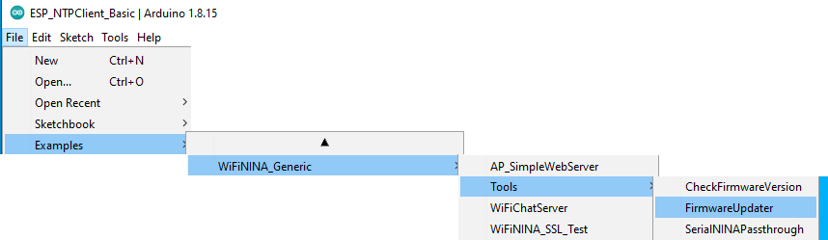
Practice – Firmware Upgrades
2
Find the Library that does the work
That may take time to navigate everywhere
Upload it to the Arduino

Slide 9
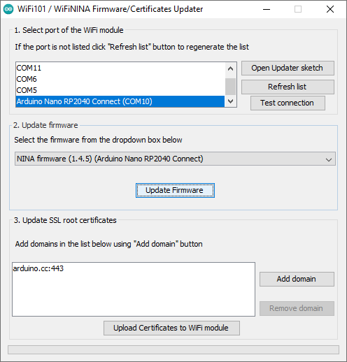
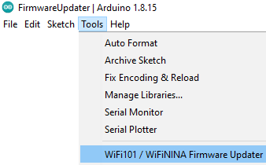
Practice – Firmware Upgrades
3
Trigger the firmware upgrade
3.B
3.A

